Slide 1
Chapter 14: Concurrency Control and
Recovery System

Slide 2
Chapter 14-1: Concurrency Control
Lock-Based Protocols
Timestamp-Based Protocols
Validation-Based Protocols
Multiple Granularity
Multiversion Schemes
Insert and Delete Operations
Concurrency in Index Structures

Slide 3
Lock-Based Protocols
A lock is a mechanism to control concurrent access to a data item
Data items can be locked in two modes :
1. exclusive (X) mode. Data item can be both read as well as
written. X-lock is requested using lock-X instruction.
2. shared (S) mode. Data item can only be read. S-lock is
requested using lock-S instruction.
Lock requests are made to concurrency-control manager. Transaction can proceed only after request is granted.

Slide 4

Lock-Based Protocols (Cont.)
Lock-compatibility matrix
A transaction may be granted a lock on an item if the requested lock is compatible with locks already held on the item by other transactions
Any number of transactions can hold shared locks on an item,
  but if any transaction holds an exclusive on the item no other transaction may hold any lock on the item.
If a lock cannot be granted, the requesting transaction is made to wait till all incompatible locks held by other transactions have been released. The lock is then granted.

Slide 5
Lock-Based Protocols (Cont.)
Example of a transaction performing locking:
T₂: lock-S(A);
read (A);
unlock(A);
lock-S(B);
read (B);
unlock(B);
display(A+B)
Locking as above is not sufficient to guarantee serializability — if A and B get updated in-between the read of A and B, the displayed sum would be wrong
A locking protocol is a set of rules followed by all transactions while requesting and releasing locks. Locking protocols restrict the set of possible schedules.

Slide 6

Pitfalls of Lock-Based Protocols
Consider the partial schedule
Neither T₃ nor T₄ can make progress — executing lock-S(B) causes T₄ to wait for T₃ to release its lock on B, while executing lock-X(A) causes T₃ to wait for T₄ to release its lock on A.
Such a situation is called a deadlock.
  To handle a deadlock one of T₃ or T₄ must be rolled back
  and its locks released.

Slide 7
Pitfalls of Lock-Based Protocols (Cont.)
The potential for deadlock exists in most locking protocols. Deadlocks are a necessary evil.
Starvation is also possible if concurrency control manager is badly designed. For example:
  A transaction may be waiting for an X-lock on an item, while a sequence of other transactions request and are granted an S-lock on the same item.
  The same transaction is repeatedly rolled back due to starvation.
Concurrency control manager can be designed to prevent starvation.

Slide 8
The Two-Phase Locking Protocol
This is a protocol which ensures conflict-serializable schedules.
Phase 1: Growing Phase
  transaction may obtain locks
  transaction may not release locks
Phase 2: Shrinking Phase
  transaction may release locks
  transaction may not obtain locks
The protocol assures serializability. It can be proved that the transactions can be serialized in the order of their lock points (i.e. the point where a transaction acquired its final lock).

Slide 9
The Two-Phase Locking Protocol (Cont.)
Two-phase locking does not ensure freedom from deadlocks
Cascading roll-back is possible under two-phase locking. To avoid this, follow a modified protocol called strict two-phase locking. Here a transaction must hold all its exclusive locks till it commits/aborts.
Rigorous two-phase locking is even stricter: here all locks are held till commit/abort. In this protocol transactions can be serialized in the order in which they commit.

Slide 10
The Two-Phase Locking Protocol (Cont.)
There can be conflict serializable schedules that cannot be obtained if two-phase locking is used.
However, in the absence of extra information (e.g., ordering of access to data), two-phase locking is needed for conflict serializability in the following sense:
Given a transaction T_{i} that does not follow two-phase locking, we can find a transaction T_{j} that uses two-phase locking, and a schedule for T_{i} and T_{j} that is not conflict serializable.

Slide 11
Lock Conversions
Two-phase locking with lock conversions:
– First Phase:
  can acquire a lock-S on item
  can acquire a lock-X on item
  can convert a lock-S to a lock-X (upgrade)
– Second Phase:
  can release a lock-S
  can release a lock-X
  can convert a lock-X to a lock-S (downgrade)
This protocol assures serializability. But still relies on the programmer to insert the various locking instructions.

Slide 12
Automatic Acquisition of Locks
A transaction T_{i} issues the standard read/write instruction, without explicit locking calls.
The operation read(D) is processed as:
if T_{i} has a lock on D
then
read(D)
else begin
if necessary wait until no other
transaction has a lock-X on D
grant T_{i} a lock-S on D;
read(D)
end

Slide 13
Automatic Acquisition of Locks (Cont.)
write(D) is processed as:
if T_{i} has a lock-X on D
then
write(D)
else begin
if necessary wait until no other trans. has any lock on D,
if T_{i} has a lock-S on D
then
upgrade lock on D to lock-X
else
grant T_{i} a lock-X on D
write(D)
end;
All locks are released after commit or abort

Slide 14
Implementation of Locking
A lock manager can be implemented as a separate process to which transactions send lock and unlock requests
The lock manager replies to a lock request by sending a lock grant messages (or a message asking the transaction to roll back, in case of a deadlock)
The requesting transaction waits until its request is answered
The lock manager maintains a data-structure called a lock table to record granted locks and pending requests
The lock table is usually implemented as an in-memory hash table indexed on the name of the data item being locked

Slide 15
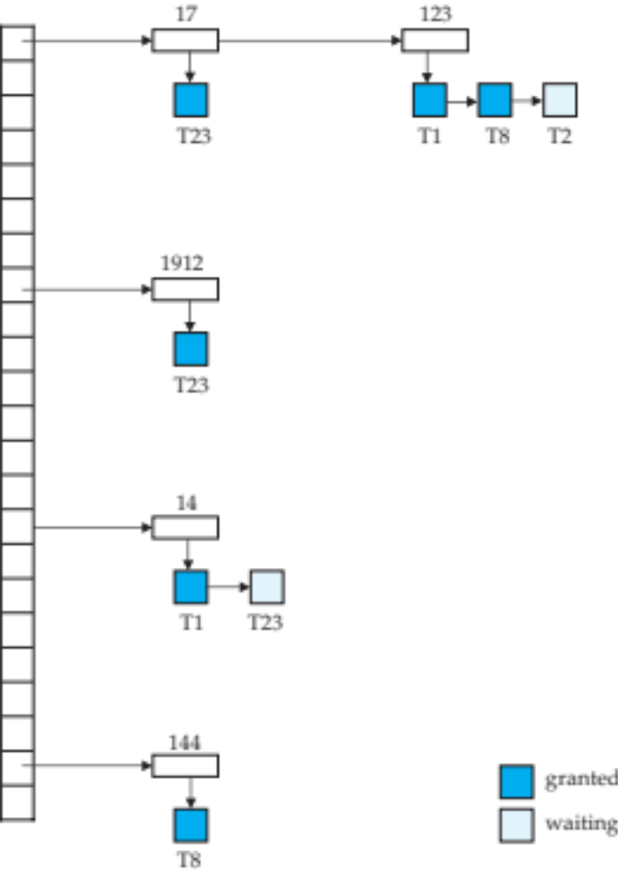
Lock Table
Black rectangles indicate granted locks, white ones indicate waiting requests
Lock table also records the type of lock granted or requested
New request is added to the end of the queue of requests for the data item, and granted if it is compatible with all earlier locks
Unlock requests result in the request being deleted, and later requests are checked to see if they can now be granted
If transaction aborts, all waiting or granted requests of the transaction are deleted
  lock manager may keep a list of locks held by each transaction, to implement this efficiently

Slide 16
Graph-Based Protocols
Graph-based protocols are an alternative to two-phase locking
Impose a partial ordering → on the set D = {d₁, d₂ ,..., d_{h}} of all data items.
  If d_{i} → d_{j} then any transaction accessing both d_{i} and d_{j} must access d_{i} before accessing d_{j}.
  Implies that the set D may now be viewed as a directed acyclic graph, called a database graph.
The tree-protocol is a simple kind of graph protocol.

Slide 17

Tree Protocol
Only exclusive locks are allowed.
The first lock by T_{i} may be on any data item. Subsequently, a data Q can be locked by T_{i} only if the parent of Q is currently locked by T_{i}.
Data items may be unlocked at any time.
A data item that has been locked and unlocked by T_{i} cannot subsequently be relocked by T_{i}

Slide 18
Graph-Based Protocols (Cont.)
The tree protocol ensures conflict serializability as well as freedom from deadlock.
Unlocking may occur earlier in the tree-locking protocol than in the two-phase locking protocol.
  shorter waiting times, and increase in concurrency
  protocol is deadlock-free, no rollbacks are required
Drawbacks
  Protocol does not guarantee recoverability or cascade freedom
    Need to introduce commit dependencies to ensure recoverability
  Transactions may have to lock data items that they do not access.
    increased locking overhead, and additional waiting time
    potential decrease in concurrency
Schedules not possible under two-phase locking are possible under tree protocol, and vice versa.

Slide 19

Deadlock Handling
Consider the following two transactions:
T₁: write (X) T₂: write(Y)
write(Y) write(X)
Schedule with deadlock

Slide 20
Deadlock Handling
System is deadlocked if there is a set of transactions such that every transaction in the set is waiting for another transaction in the set.
Deadlock prevention protocols ensure that the system will never enter into a deadlock state. Some prevention strategies :
  Require that each transaction locks all its data items before it begins execution (predeclaration).
  Impose partial ordering of all data items and require that a transaction can lock data items only in the order specified by the partial order (graph-based protocol).

Slide 21
More Deadlock Prevention Strategies
Following schemes use transaction timestamps for the sake of deadlock prevention alone.
wait-die scheme — non-preemptive
  older transaction may wait for younger one to release data item. Younger transactions never wait for older ones; they are rolled back instead.
  a transaction may die several times before acquiring needed data item
wound-wait scheme — preemptive
  older transaction wounds (forces rollback) of younger transaction instead of waiting for it. Younger transactions may wait for older ones.
  may be fewer rollbacks than wait-die scheme.

Slide 22
Deadlock prevention (Cont.)
Both in wait-die and in wound-wait schemes, a rolled back transactions is restarted with its original timestamp. Older transactions thus have precedence over newer ones, and starvation is hence avoided.
Timeout-Based Schemes:
  a transaction waits for a lock only for a specified amount of time. After that, the wait times out and the transaction is rolled back.
  thus deadlocks are not possible
  simple to implement; but starvation is possible. Also difficult to determine good value of the timeout interval.

Slide 23
Deadlock Detection
Deadlocks can be described as a wait-for graph, which consists of a pair G = (V,E),
  V is a set of vertices (all the transactions in the system)
  E is a set of edges; each element is an ordered pair T_{i} →T_{j}.
If T_{i} → T_{j} is in E, then there is a directed edge from T_{i} to T_{j}, implying that T_{i} is waiting for T_{j} to release a data item.
When T_{i} requests a data item currently being held by T_{j}, then the edge T_{i} T_{j} is inserted in the wait-for graph. This edge is removed only when T_{j} is no longer holding a data item needed by T_{i}.
The system is in a deadlock state if and only if the wait-for graph has a cycle. Must invoke a deadlock-detection algorithm periodically to look for cycles.

Slide 24


Deadlock Detection (Cont.)
Wait-for graph without a cycle
Wait-for graph with a cycle

Slide 25
Deadlock Recovery
When deadlock is detected :
  Some transaction will have to rolled back (made a victim) to break deadlock. Select that transaction as victim that will incur minimum cost.
  Rollback -- determine how far to roll back transaction
    Total rollback: Abort the transaction and then restart it.
    More effective to roll back transaction only as far as necessary to break deadlock.
  Starvation happens if same transaction is always chosen as victim. Include the number of rollbacks in the cost factor to avoid starvation

Slide 26
Multiple Granularity
Allow data items to be of various sizes and define a hierarchy of data granularities, where the small granularities are nested within larger ones
Can be represented graphically as a tree (but don't confuse with tree-locking protocol)
When a transaction locks a node in the tree explicitly, it implicitly locks all the node's descendents in the same mode.
Granularity of locking (level in tree where locking is done):
  fine granularity (lower in tree): high concurrency, high locking overhead
  coarse granularity (higher in tree): low locking overhead, low concurrency

Slide 27

Example of Granularity Hierarchy
The levels, starting from the coarsest (top) level are
  database
  area
  file
  record

Slide 28
Intention Lock Modes
In addition to S and X lock modes, there are three additional lock modes with multiple granularity:
  intention-shared (IS): indicates explicit locking at a lower level of the tree but only with shared locks.
  intention-exclusive (IX): indicates explicit locking at a lower level with exclusive or shared locks
  shared and intention-exclusive (SIX): the subtree rooted by that node is locked explicitly in shared mode and explicit locking is being done at a lower level with exclusive-mode locks.
intention locks allow a higher level node to be locked in S or X mode without having to check all descendent nodes.

Slide 29

Compatibility Matrix with Intention Lock Modes
The compatibility matrix for all lock modes is:

Slide 30
Multiple Granularity Locking Scheme
Transaction T_{i} can lock a node Q, using the following rules:
  The lock compatibility matrix must be observed.
  The root of the tree must be locked first, and may be locked in any mode.
  A node Q can be locked by T_{i} in S or IS mode only if the parent of Q is currently locked by T_{i} in either IX or IS mode.
  A node Q can be locked by T_{i} in X, SIX, or IX mode only if the parent of Q is currently locked by T_{i} in either IX or SIX mode.
  T_{i} can lock a node only if it has not previously unlocked any node (that is, T_{i} is two-phase).
  T_{i} can unlock a node Q only if none of the children of Q are currently locked by T_{i}.
Observe that locks are acquired in root-to-leaf order, whereas they are released in leaf-to-root order.
Lock granularity escalation: in case there are too many locks at a particular level, switch to higher granularity S or X lock

Slide 31
Timestamp-Based Protocols
Each transaction is issued a timestamp when it enters the system. If an old transaction T_{i} has time-stamp TS(T_{i}), a new transaction T_{j} is assigned time-stamp TS(T_{j}) such that TS(T_{i}) <TS(T_{j}).
The protocol manages concurrent execution such that the time-stamps determine the serializability order.
In order to assure such behavior, the protocol maintains for each data Q two timestamp values:
  W-timestamp(Q) is the largest time-stamp of any transaction that executed write(Q) successfully.
  R-timestamp(Q) is the largest time-stamp of any transaction that executed read(Q) successfully.

Slide 32
Timestamp-Based Protocols (Cont.)
The timestamp ordering protocol ensures that any conflicting read and write operations are executed in timestamp order.
Suppose a transaction T_{i} issues a read(Q)
  If TS(T_{i}) ≤ W-timestamp(Q), then T_{i} needs to read a value of Q that was already overwritten.
    Hence, the read operation is rejected, and T_{i} is rolled back.
  If TS(T_{i})≥ W-timestamp(Q), then the read operation is executed, and R-timestamp(Q) is set to max(R-timestamp(Q), TS(T_{i})).

Slide 33
Timestamp-Based Protocols (Cont.)
Suppose that transaction T_{i} issues write(Q).
  If TS(T_{i}) < R-timestamp(Q), then the value of Q that T_{i} is producing was needed previously, and the system assumed that that value would never be produced.
    Hence, the write operation is rejected, and T_{i} is rolled back.
  If TS(T_{i}) < W-timestamp(Q), then T_{i} is attempting to write an obsolete value of Q.
    Hence, this write operation is rejected, and T_{i} is rolled back.
  Otherwise, the write operation is executed, and W-timestamp(Q) is set to TS(T_{i}).

Slide 34

Example Use of the Protocol
A partial schedule for several data items for transactions with
timestamps 1, 2, 3, 4, 5

Slide 35

Correctness of Timestamp-Ordering Protocol
The timestamp-ordering protocol guarantees serializability since all the arcs in the precedence graph are of the form:
Thus, there will be no cycles in the precedence graph
Timestamp protocol ensures freedom from deadlock as no transaction ever waits.
But the schedule may not be cascade-free, and may not even be recoverable.

Slide 36
Recoverability and Cascade Freedom
Problem with timestamp-ordering protocol:
  Suppose T_{i} aborts, but T_{j} has read a data item written by T_{i}
  Then T_{j} must abort; if T_{j} had been allowed to commit earlier, the schedule is not recoverable.
  Further, any transaction that has read a data item written by T_{j} must abort
  This can lead to cascading rollback --- that is, a chain of rollbacks
Solution 1:
  A transaction is structured such that its writes are all performed at the end of its processing
  All writes of a transaction form an atomic action; no transaction may execute while a transaction is being written
  A transaction that aborts is restarted with a new timestamp
Solution 2: Limited form of locking: wait for data to be committed before reading it
Solution 3: Use commit dependencies to ensure recoverability

Slide 37
Thomas’ Write Rule
Modified version of the timestamp-ordering protocol in which obsolete write operations may be ignored under certain circumstances.
When T_{i} attempts to write data item Q, if TS(T_{i}) < W-timestamp(Q), then T_{i} is attempting to write an obsolete value of {Q}.
  Rather than rolling back T_{i} as the timestamp ordering protocol would have done, this {write} operation can be ignored.
Otherwise this protocol is the same as the timestamp ordering protocol.
Thomas' Write Rule allows greater potential concurrency.
  Allows some view-serializable schedules that are not conflict-serializable.

Slide 38
View Serializability
Let S and S´ be two schedules with the same set of transactions. S and S´ are view equivalent if the following three conditions are met, for each data item Q,
  If in schedule S, transaction T_{i} reads the initial value of Q, then in schedule S’ also transaction T_{i} must read the initial value of Q.
  If in schedule S transaction T_{i} executes read(Q), and that value was produced by transaction T_{j} (if any), then in schedule S’ also transaction T_{i} must read the value of Q that was produced by the same write(Q) operation of transaction T_{j} .
  The transaction (if any) that performs the final write(Q) operation in schedule S must also perform the final write(Q) operation in schedule S’.
As can be seen, view equivalence is also based purely on reads and writes alone.

Slide 39
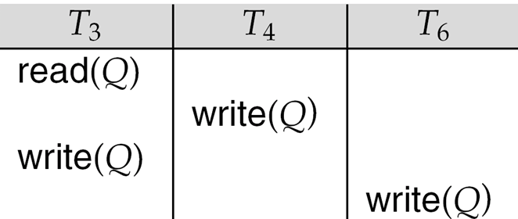
View Serializability (Cont.)
A schedule S is view serializable if it is view equivalent to a serial schedule.
Every conflict serializable schedule is also view serializable.
Below is a schedule which is view-serializable but not conflict serializable.
What serial schedule is above equivalent to?
Every view serializable schedule that is not conflict serializable has blind writes.

Slide 40
Test for View Serializability
The precedence graph test for conflict serializability cannot be used directly to test for view serializability.
  Extension to test for view serializability has cost exponential in the size of the precedence graph.
The problem of checking if a schedule is view serializable falls in the class of NP-complete problems.
  Thus existence of an efficient algorithm is extremely unlikely.
However practical algorithms that just check some sufficient conditions for view serializability can still be used.

Slide 41
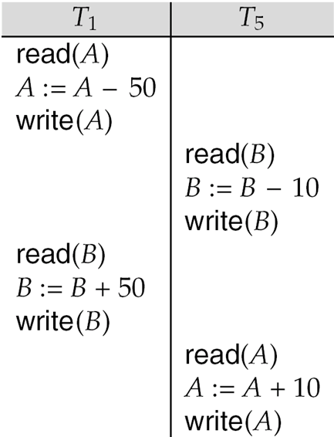
Other Notions of Serializability
The schedule below produces same outcome as the serial schedule < T₁, T₅ >, yet is not conflict equivalent or view equivalent to it.
Determining such equivalence requires analysis of operations other than read and write.
  Operation-conflicts, operation locks

Slide 42
Validation-Based Protocol
Execution of transaction T_{i} is done in three phases.
1. Read and execution phase: Transaction T_{i} writes only to
temporary local variables
2. Validation phase: Transaction T_{i} performs a ``validation test''
to determine if local variables can be written without violating
serializability.
3. Write phase: If T_{i} is validated, the updates are applied to the
database; otherwise, T_{i} is rolled back.
The three phases of concurrently executing transactions can be interleaved, but each transaction must go through the three phases in that order.
  Assume for simplicity that the validation and write phase occur together, atomically and serially
    I.e., only one transaction executes validation/write at a time.
Also called as optimistic concurrency control since transaction executes fully in the hope that all will go well during validation

Slide 43
Validation-Based Protocol (Cont.)
Each transaction T_{i} has 3 timestamps
  Start(T_{i}) : the time when T_{i} started its execution
  Validation(T_{i}): the time when T_{i} entered its validation phase
  Finish(T_{i}) : the time when T_{i} finished its write phase
Serializability order is determined by timestamp given at validation time, to increase concurrency.
  Thus TS(T_{i}) is given the value of Validation(T_{i}).
This protocol is useful and gives greater degree of concurrency if probability of conflicts is low.
  because the serializability order is not pre-decided, and
  relatively few transactions will have to be rolled back.

Slide 44
Validation Test for Transaction T_{j}
If for all T_{i} with TS (T_{i}) < TS (T_{j}) either one of the following condition holds:
  finish(T_{i}) < start(T_{j})
  start(T_{j}) < finish(T_{i}) < validation(T_{j}) and the set of data items written by T_{i} does not intersect with the set of data items read by T_{j}.
then validation succeeds and T_{j} can be committed. Otherwise, validation fails and T_{j} is aborted.
Justification: Either the first condition is satisfied, and there is no overlapped execution, or the second condition is satisfied and
  the writes of T_{j} do not affect reads of T_{i} since they occur after T_{i} has finished its reads.
  the writes of T_{i} do not affect reads of T_{j} since T_{j} does not read any item written by T_{i}.

Slide 45

Schedule Produced by Validation
Example of schedule produced using validation

Slide 46
Multiversion Schemes
Multiversion schemes keep old versions of data item to increase concurrency.
  Multiversion Timestamp Ordering
  Multiversion Two-Phase Locking
Each successful write results in the creation of a new version of the data item written.
Use timestamps to label versions.
When a read(Q) operation is issued, select an appropriate version of Q based on the timestamp of the transaction, and return the value of the selected version.
reads never have to wait as an appropriate version is returned immediately.

Slide 47
Multiversion Timestamp Ordering
Each data item Q has a sequence of versions <Q₁, Q₂,...., Q_{m}>. Each version Q_{k} contains three data fields:
  Content -- the value of version Q_{k}.
  W-timestamp(Q_{k}) -- timestamp of the transaction that created (wrote) version Q_{k}
  R-timestamp(Q_{k}) -- largest timestamp of a transaction that successfully read version Q_{k}
when a transaction T_{i} creates a new version Q_{k} of Q, Q_{k}'s W-timestamp and R-timestamp are initialized to TS(T_{i}).
R-timestamp of Q_{k} is updated whenever a transaction T_{j} reads Q_{k}, and TS(T_{j}) > R-timestamp(Q_{k}).

Slide 48
Multiversion Timestamp Ordering (Cont)
Suppose that transaction T_{i} issues a read(Q) or write(Q) operation. Let Q_{k} denote the version of Q whose write timestamp is the largest write timestamp less than or equal to TS(T_{i}).
  If transaction T_{i} issues a read(Q), then the value returned is the content of version Q_{k}.
  If transaction T_{i} issues a write(Q)
    if TS(T_{i}) < R-timestamp(Q_{k}), then transaction T_{i} is rolled back.
    if TS(T_{i}) = W-timestamp(Q_{k}), the contents of Q_{k} are overwritten
    else a new version of Q is created.
Observe that
  Reads always succeed
  A write by T_{i} is rejected if some other transaction T_{j} that (in the serialization order defined by the timestamp values) should read
  T_{i}'s write, has already read a version created by a transaction older than T_{i}.
Protocol guarantees serializability

Slide 49
Multiversion Two-Phase Locking
Differentiates between read-only transactions and update transactions
Update transactions acquire read and write locks, and hold all locks up to the end of the transaction. That is, update transactions follow rigorous two-phase locking.
  Each successful write results in the creation of a new version of the data item written.
  each version of a data item has a single timestamp whose value is obtained from a counter ts-counter that is incremented during commit processing.
Read-only transactions are assigned a timestamp by reading the current value of ts-counter before they start execution; they follow the multiversion timestamp-ordering protocol for performing reads.

Slide 50
Multiversion Two-Phase Locking (Cont.)
When an update transaction wants to read a data item:
  it obtains a shared lock on it, and reads the latest version.
When it wants to write an item
  it obtains X lock on; it then creates a new version of the item and sets this version's timestamp to ∞.
When update transaction T_{i} completes, commit processing occurs:
  T_{i} sets timestamp on the versions it has created to ts-counter + 1
  T_{i} increments ts-counter by 1
Read-only transactions that start after T_{i} increments ts-counter will see the values updated by T_{i}.
Read-only transactions that start before T_{i} increments the
ts-counter will see the value before the updates by T_{i}.
Only serializable schedules are produced.

Slide 51
MVCC: Implementation Issues
Creation of multiple versions increases storage overhead
  Extra tuples
  Extra space in each tuple for storing version information
Versions can, however, be garbage collected
  E.g. if Q has two versions Q5 and Q9, and the oldest active transaction has timestamp > 9, than Q5 will never be required again

Slide 52
Chapter 14-2: Recovery System
Failure Classification
Storage Structure
Recovery and Atomicity
Log-Based Recovery
Remote Backup Systems

Slide 53
Failure Classification
Transaction failure :
  Logical errors: transaction cannot complete due to some internal error condition
  System errors: the database system must terminate an active transaction due to an error condition (e.g., deadlock)
System crash: a power failure or other hardware or software failure causes the system to crash.
  Fail-stop assumption: non-volatile storage contents are assumed to not be corrupted by system crash
    Database systems have numerous integrity checks to prevent corruption of disk data
Disk failure: a head crash or similar disk failure destroys all or part of disk storage
  Destruction is assumed to be detectable: disk drives use checksums to detect failures

Slide 54
Recovery Algorithms
Consider transaction T_{i} that transfers $50 from account A to account B
  Two updates: subtract 50 from A and add 50 to B
Transaction T_{i} requires updates to A and B to be output to the database.
  A failure may occur after one of these modifications have been made but before both of them are made.
  Modifying the database without ensuring that the transaction will commit may leave the database in an inconsistent state
  Not modifying the database may result in lost updates if failure occurs just after transaction commits
Recovery algorithms have two parts
  Actions taken during normal transaction processing to ensure enough information exists to recover from failures
  Actions taken after a failure to recover the database contents to a state that ensures atomicity, consistency and durability

Slide 55
Storage Structure
Volatile storage:
  does not survive system crashes
  examples: main memory, cache memory
Nonvolatile storage:
  survives system crashes
  examples: disk, tape, flash memory,
  non-volatile (battery backed up) RAM
  but may still fail, losing data
Stable storage:
  a mythical form of storage that survives all failures
  approximated by maintaining multiple copies on distinct nonvolatile media
  See book for more details on how to implement stable storage

Slide 56
Stable-Storage Implementation
Maintain multiple copies of each block on separate disks
  copies can be at remote sites to protect against disasters such as fire or flooding.
Failure during data transfer can still result in inconsistent copies: Block transfer can result in
  Successful completion
  Partial failure: destination block has incorrect information
  Total failure: destination block was never updated
Protecting storage media from failure during data transfer (one solution):
  Execute output operation as follows (assuming two copies of each block):
    Write the information onto the first physical block.
    When the first write successfully completes, write the same information onto the second physical block.
    The output is completed only after the second write successfully completes.

Slide 57
Stable-Storage Implementation (Cont.)
Protecting storage media from failure during data transfer (cont.):
Copies of a block may differ due to failure during output operation. To recover from failure:
  First find inconsistent blocks:
    Expensive solution: Compare the two copies of every disk block.
    Better solution:
      Record in-progress disk writes on non-volatile storage (Non-volatile RAM or special area of disk).
      Use this information during recovery to find blocks that may be inconsistent, and only compare copies of these.
      Used in hardware RAID systems
  If either copy of an inconsistent block is detected to have an error (bad checksum), overwrite it by the other copy. If both have no error, but are different, overwrite the second block by the first block.

Slide 58
Data Access
Physical blocks are those blocks residing on the disk.
Buffer blocks are the blocks residing temporarily in main memory.
Block movements between disk and main memory are initiated through the following two operations:
  input(B) transfers the physical block B to main memory.
  output(B) transfers the buffer block B to the disk, and replaces the appropriate physical block there.
We assume, for simplicity, that each data item fits in, and is stored inside, a single block.

Slide 59
Example of Data Access
buffer
Buffer Block A
input(A)
X
A
Buffer Block B
Y
B
output(B)
read(X)
write(Y)
x₂
x₁
y₁
work area
of T₁
work area
of T₂
memory
disk

Slide 60
Data Access (Cont.)
Each transaction T_{i} has its private work-area in which local copies of all data items accessed and updated by it are kept.
  T_{i}'s local copy of a data item X is called x_{i}.
Transferring data items between system buffer blocks and its private work-area done by:
  read(X) assigns the value of data item X to the local variable x_{i}.
  write(X) assigns the value of local variable x_{i} to data item {X} in the buffer block.
  Note: output(B_{X}) need not immediately follow write(X). System can perform the output operation when it deems fit.
Transactions
  Must perform read(X) before accessing X for the first time (subsequent reads can be from local copy)
  write(X) can be executed at any time before the transaction commits

Slide 61
Recovery and Atomicity
To ensure atomicity despite failures, we first output information describing the modifications to stable storage without modifying the database itself.
We study log-based recovery mechanisms in detail
  We first present key concepts
  And then present the actual recovery algorithm
Less used alternative: shadow-paging (brief details in book)

Slide 62
Log-Based Recovery
A log is kept on stable storage.
  The log is a sequence of log records, and maintains a record of update activities on the database.
When transaction T_{i} starts, it registers itself by writing a
<T_{i} start>log record
Before T_{i} executes write(X), a log record
<T_{i}, X, V₁, V₂>
is written, where V₁ is the value of X before the write (the old value), and V₂ is the value to be written to X (the new value).
When T_{i} finishes it last statement, the log record <T_{i} commit> is written.
Two approaches using logs
  Deferred database modification
  Immediate database modification

Slide 63
Immediate Database Modification
The immediate-modification scheme allows updates of an uncommitted transaction to be made to the buffer, or the disk itself, before the transaction commits
Update log record must be written before database item is written
  We assume that the log record is output directly to stable storage
  (Will see later that how to postpone log record output to some extent)
Output of updated blocks to stable storage can take place at any time before or after transaction commit
Order in which blocks are output can be different from the order in which they are written.
The deferred-modification scheme performs updates to buffer/disk only at the time of transaction commit
  Simplifies some aspects of recovery
  But has overhead of storing local copy

Slide 64
Transaction Commit
A transaction is said to have committed when its commit log record is output to stable storage
  all previous log records of the transaction must have been output already
Writes performed by a transaction may still be in the buffer when the transaction commits, and may be output later

Slide 65
Immediate Database Modification Example
Log Write Output
<T₀ start>
<T₀, A, 1000, 950>
<T_{o}, B, 2000, 2050
A = 950
B = 2050
<T₀ commit>
<T₁ start>
<T₁, C, 700, 600>
C = 600
B_{B} , B_{C}
<T₁ commit>
B_{A}
Note: B_{X} denotes block containing X.
B_{C} output before T₁ commits
B_{A} output after T₀ commits

Slide 66
Concurrency Control and Recovery
With concurrent transactions, all transactions share a single disk buffer and a single log
  A buffer block can have data items updated by one or more transactions
We assume that if a transaction T_{i} has modified an item, no other transaction can modify the same item until T_{i} has committed or aborted
  i.e. the updates of uncommitted transactions should not be visible to other transactions
    Otherwise how to perform undo if T1 updates A, then T2 updates A and commits, and finally T1 has to abort?
  Can be ensured by obtaining exclusive locks on updated items and holding the locks till end of transaction (strict two-phase locking)
Log records of different transactions may be interspersed in the log.

Slide 67
Undo and Redo Operations
Undo of a log record <T_{i}, X, V₁, V₂> writes the old value V₁ to X
Redo of a log record <T_{i}, X, V₁, V₂> writes the new value V₂ to X
Undo and Redo of Transactions
  undo(T_{i}) restores the value of all data items updated by T_{i} to their old values, going backwards from the last log record for T_{i}
    each time a data item X is restored to its old value V a special log record <T_{i} , X, V> is written out
    when undo of a transaction is complete, a log record
    <T_{i} abort> is written out.
  redo(T_{i}) sets the value of all data items updated by T_{i} to the new values, going forward from the first log record for T_{i}
    No logging is done in this case

Slide 68
Undo and Redo on Recovering from Failure
When recovering after failure:
  Transaction T_{i} needs to be undone if the log
    contains the record <T_{i} start>,
    but does not contain either the record <T_{i} commit> or <T_{i} abort>.
  Transaction T_{i} needs to be redone if the log
    contains the records <T_{i} start>
    and contains the record <T_{i} commit> or <T_{i} abort>
Note that If transaction T_{i} was undone earlier and the <T_{i} abort> record written to the log, and then a failure occurs, on recovery from failure T_{i} is redone
  such a redo redoes all the original actions including the steps that restored old values
    Known as repeating history
    Seems wasteful, but simplifies recovery greatly

Slide 69

Immediate DB Modification Recovery Example
Below we show the log as it appears at three instances of time.
Recovery actions in each case above are:
(a) undo (T₀): B is restored to 2000 and A to 1000, and log records
<T₀, B, 2000>, <T₀, A, 1000>, <T₀, abort> are written out
(b) redo (T₀) and undo (T₁): A and B are set to 950 and 2050 and C is restored to 700. Log records <T₁, C, 700>, <T₁, abort> are written out.
(c) redo (T₀) and redo (T₁): A and B are set to 950 and 2050
respectively. Then C is set to 600

Slide 70
Checkpoints
Redoing/undoing all transactions recorded in the log can be very slow
  processing the entire log is time-consuming if the system has run for a long time
  we might unnecessarily redo transactions which have already output their updates to the database.
Streamline recovery procedure by periodically performing checkpointing
  Output all log records currently residing in main memory onto stable storage.
  Output all modified buffer blocks to the disk.
  Write a log record < checkpoint L> onto stable storage where L is a list of all transactions active at the time of checkpoint.
  All updates are stopped while doing checkpointing

Slide 71
Checkpoints (Cont.)
During recovery we need to consider only the most recent transaction T_{i} that started before the checkpoint, and transactions that started after T_{i}.
  Scan backwards from end of log to find the most recent <checkpoint L> record
  Only transactions that are in L or started after the checkpoint need to be redone or undone
  Transactions that committed or aborted before the checkpoint already have all their updates output to stable storage.
Some earlier part of the log may be needed for undo operations
  Continue scanning backwards till a record <T_{i} start> is found for every transaction T_{i} in L.
  Parts of log prior to earliest <T_{i} start> record above are not needed for recovery, and can be erased whenever desired.

Slide 72
Example of Checkpoints
T_{c}
T_{f}
T₁ can be ignored (updates already output to disk due to checkpoint)
T₂ and T₃ redone.
T₄ undone
T₁
T₂
T₃
T₄
checkpoint
system failure

Slide 73
Exercises
Practice Exercises:
  14.1 14.2 14.3 14.14 14.15
Exercises:
  14.21 14.24 14.34 14.36 14.37

Slide 74
End of Chapter

